Slide 1
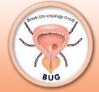
Impact of the Covid-19 pandemic: findings from the National Prostate Cancer Audit
Commissioned by HQIP on behalf of NHS England and Welsh Government
Based at the Clinical Effectiveness Unit, Royal College of Surgeons / London School of Hygiene & Tropical Medicine
Clinical leadership provided by BAUS and BUG
Data partners: National Cancer Registry and Analysis Service, Wales Cancer Network

Slide 2
Impact of the Covid-19 pandemic: findings from the National Prostate Cancer Audit
Julie Nossiter
Audit Lead, RCS/ Assistant Professor, LSHTM
NPCA Project Team:
NPCA Clinical Leads: Noel Clarke / Heather Payne
NPCA Clinicians: Ajay Aggarwal / Paul Cathcart / Joanna Dodkins / Matt Parry
Arun Sujenthiran / Brendan Berry / Arjun Nathan
RCS-LSHTM: Jan Van der Meulen / Julie Nossiter / Mel Morris / Adrian Cook

Slide 3
Diagnosis and treatment of men with prostate cancer during the Covid-19 pandemic
Aims:
Evaluate the impact on the diagnosis and treatment of men with prostate cancer (PCa)
Quantify the proportion of the ‘at risk’ population who have experienced delays or changes in care

Slide 4
Diagnosis and treatment of men with prostate cancer during the Covid-19 pandemic
Methods:
Diagnostic and treatment activity was determined across all NHS hospital providers of PCa care in England
compared with the same calendar periods in 2019
Considered patients to be diagnosed or treated in the initial phase of the pandemic if date of diagnosis/treatment was between 23.03.20 (start of the first lockdown) – 04.07.20 (restrictions eased)

Slide 5
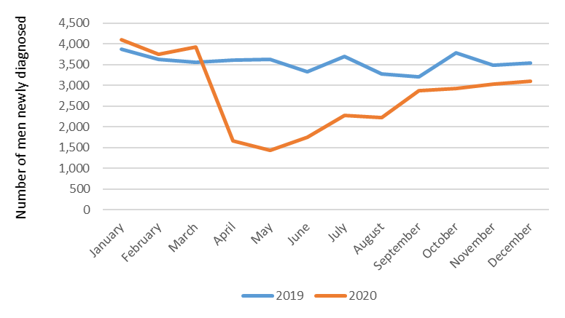
Prostate cancer diagnoses
48.3% reduction (6,247 vs 12,066) in the number of men newly diagnosed during the first lockdown in 2020 compared with the corresponding period in 2019

Slide 6
Prostate cancer diagnoses
Overall, 30.8% reduction (22,419 vs 32,409) in the number of men newly diagnosed after the start of the first lockdown to the end of 2020 compared with 2019

Slide 7
Prostate cancer diagnoses
Men were more likely to be diagnosed at a more advanced stage (21.2% vs 17.4%, stage IV; 2020 vs 2019) and were slightly older (57.9% vs 55.9% ≥ 70 years, p<0.001)

Slide 8
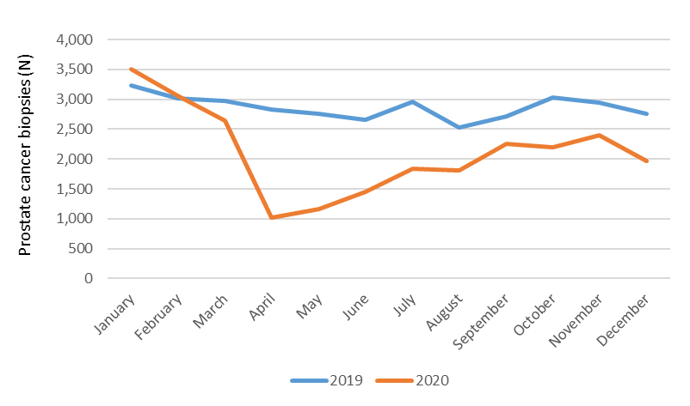
Prostate biopsies
Corresponding reduction in the number of prostate biopsies performed

Slide 9
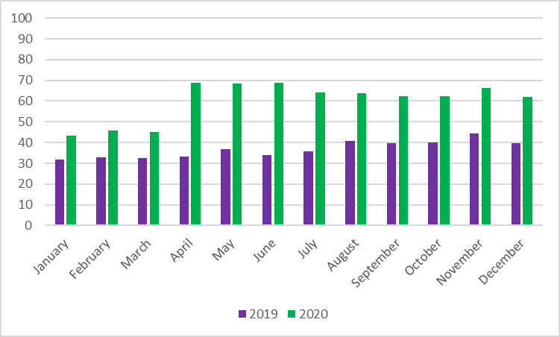
Prostate biopsies
More often performed through the transperineal (TP) vs transrectal (TR) route after the start of the first lockdown in 2020 compared with the corresponding period in 2019 (TP vs TR, 64.0% vs 38.2%)
Transperineal biopsies (%)

Slide 10
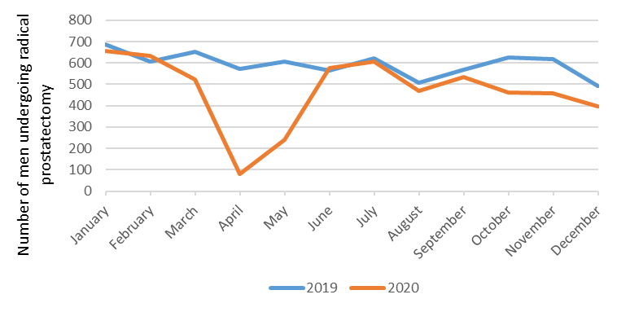
Surgery (radical prostatectomy, RP)
46.3% reduction (1,076 vs 2,005) in the number undergoing RP during the first lockdown compared with the same calendar period in 2019

Slide 11
Surgery (radical prostatectomy, RP)
Overall, 26.9% reduction (3,896 vs 5,331) in the number of men undergoing surgery

Slide 12
Surgery (radical prostatectomy, RP)
Cancer stage in men undergoing RP was less advanced than those in 2019 (34.8%% vs 39.6%, stage 3; 2020 vs 2019)

Slide 13
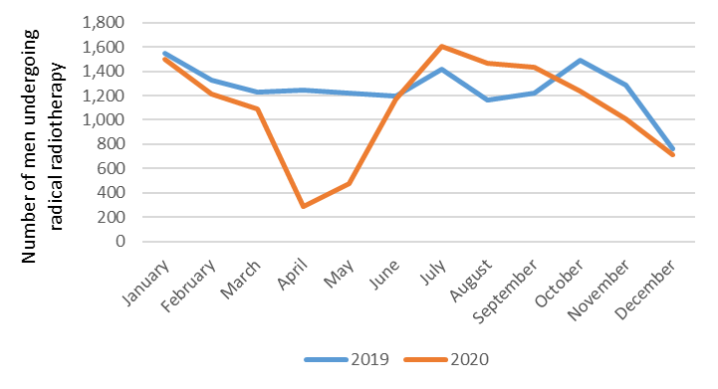
Radiotherapy (radical EBRT)
45.4% reduction (2,339 vs 4,287) in the number undergoing EBRT during the first lockdown compared with the same calendar period in 2019

Slide 14
Radiotherapy (radical EBRT)
Overall, 14.1% reduction (9,719 vs 11,309) in the number of men undergoing EBRT

Slide 15
Radiotherapy (radical EBRT)
Other changes included an increased use of a hypofractionation (83.1% vs 78.1%) compared with 2019

Slide 16
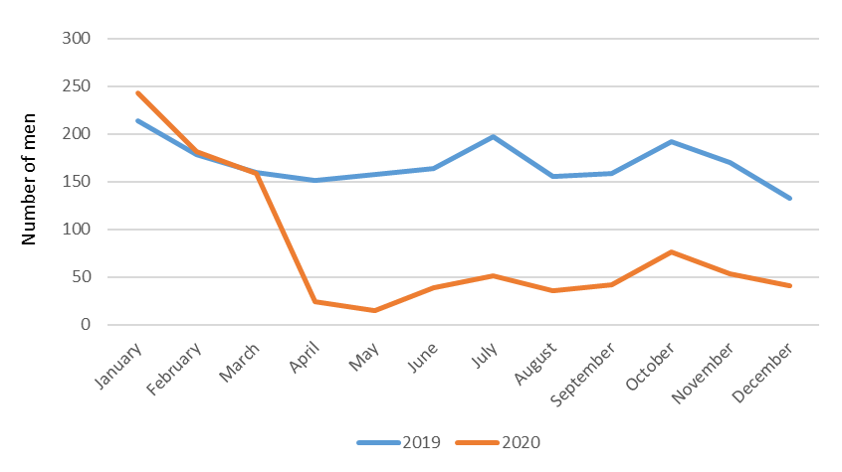
Systemic treatment: hormone-sensitive PCa
Rapid and marked fall (72.8% reduction) in the use of docetaxel after the start of the first lockdown in 2020 compared with the corresponding period in 2019 (413 vs 1,519)

Slide 17
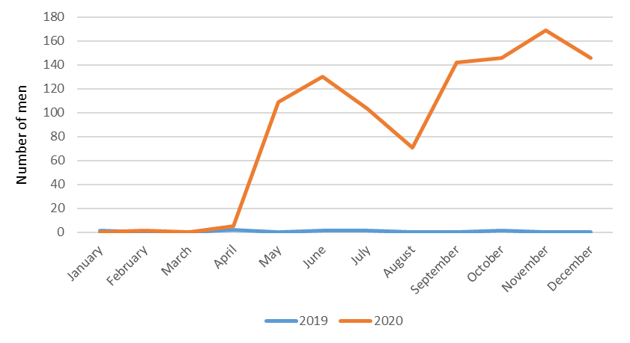
Systemic treatment: hormone-sensitive PCa
Marked increase in the use of enzalutamide in men with hormone-sensitive PCa compared with 2019 (5 vs 1,040)

Slide 18
Conclusions
Although diagnostic and treatment activity rapidly increased after the end of the first national lockdown >> ongoing deficits by December 2020
 | Deficit (23rd Mar to 31st Dec) | % reduction (2020 vs 2019)
Diagnoses | 9,990 | 30.8
Radical prostatectomy | 1,435 | 26.9
Radical radiotherapy | 1,590 | 14.1
Significant additional capacity to address this backlog

Slide 19
Conclusions
Care changed and shift towards patterns that limit the risk of Covid-19 exposure for patients during treatment
accelerated uptake of transperineal biopsies
increased the use of hypofractionation
substitution of docetaxel >> enzalutamide

Slide 20
Next steps for the NPCA
Report on the variation by region and cancer alliance >> Annual Report published 13.01.22
Determine the impact of changes in diagnostic and treatment pathways during 2020 on patient outcomes >> impact of delaying RP in high-risk disease +/- ADT
Explore the impact of subsequent phases of the pandemic and ongoing measures to reduce transmission during 2021 on the recovery of PCa services

Slide 21
Thank you!
Please post your questions for discussion by the panel in the Q&A box

Slide 22
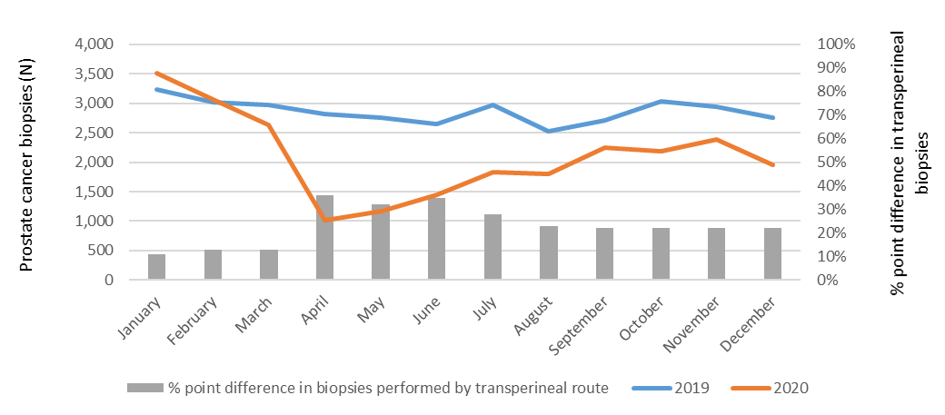
Prostate biopsies
More often performed through the transperineal route after the start of the first lockdown in 2020 compared with the corresponding period in 2019 (TP vs TR, 64.0% vs 38.2%)

